Slide 1
Java Lecture 6

Slide 2
Java Basics
Searching in array
    In this process a given number is searched in the entire array ,If it is in array then we locate the position.
Types of Searching:
    Linear Search
    Binary Search

Slide 3
Java Basics
Linear search:-
    In this method an element is searched in the array in linear way i.e. first element at zero index is checked after that element at first index and so on.
Binary search:-
    To perform Binary Search Array sould be sorted. Search a sorted array by repeatedly dividing the search interval in half. Begin with an interval covering the whole array. If the value of the search key is less than the item in the middle of the interval, narrow the interval to the lower half. Otherwise narrow it to the upper half. Repeatedly check until the value is found or the interval is empty.

Slide 4
Java Basics
Sorting of array:-
  To array element of array in ascending or descending order.
Types of sorting:-
  Selection sort.
  Bubble sort.
  Insertion sort.

Slide 5
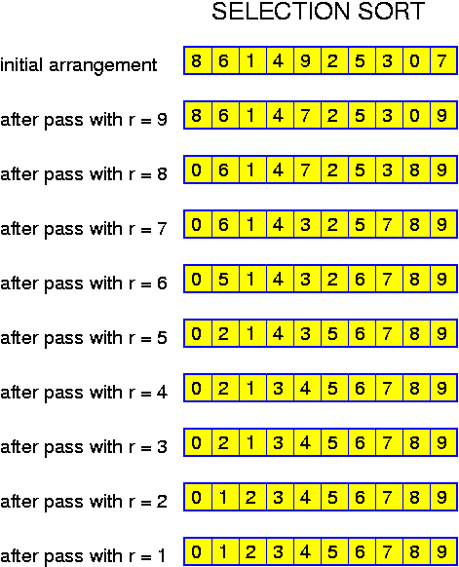
Java Basics
Selection sort:-
    Example:

Slide 6
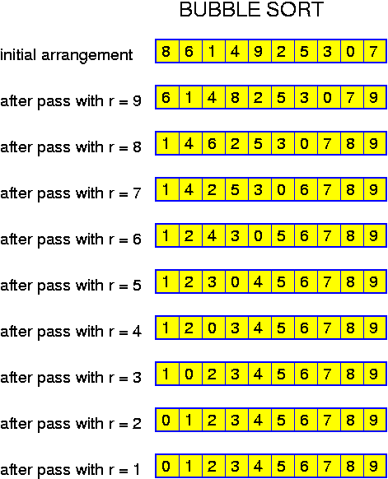
Java Basics
Bubble sort:-
  Example:-

Slide 7
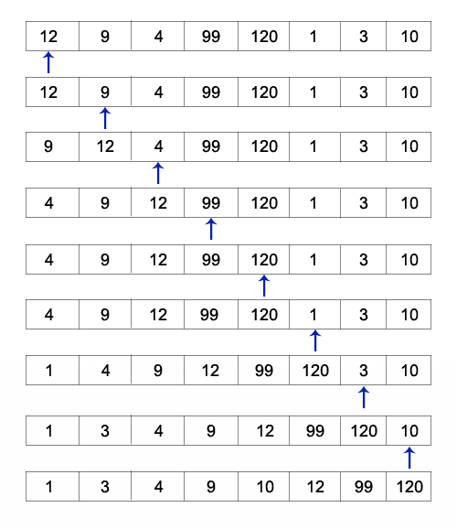
Java Basics
Insertion sort:
  Example:-

